Slide 1

Data Science Capstone
Priyank Shah

Slide 2
Introduction
This project is to analyze the districts in Houston and find one for a young couple in their 20’s.
They enjoy going to wine bars and yoga studios and would prefer a location where these are in plenty.
The objective of this project is to analyze the districts in Houston and find one that fits this couples needs.

Slide 3
Data SETS
DISTRICT DATA SET
This dataset is extracted from the Wikipedia page and we use Beautiful Soup to scrape the webpage.
Geocoding Data:
This dataset is obtained using the geocoding API that are then used in the datafrAME
Venue:
This dataset is obtained from the Foursquare API. We get information about venues around the Houston districts.

Slide 4
Methodology
Website scraping:
This involves using Beautiful soup to get data of the Wikipedia page for Houston: 'https://en.wikipedia.org/wiki/List_of_Houston_neighborhoods
Geocoding:
This involves using the Geocoding API to get the location coordinates for each district
FOURSQUARE API:
This API was used to get all the venues in each district
Clustering:
K-means clustering algorithm was used to create clusters of neighborhoods. Since there are so many venues, K-means was the best option
Folium:
The folium library was used to display data on maps.

Slide 5
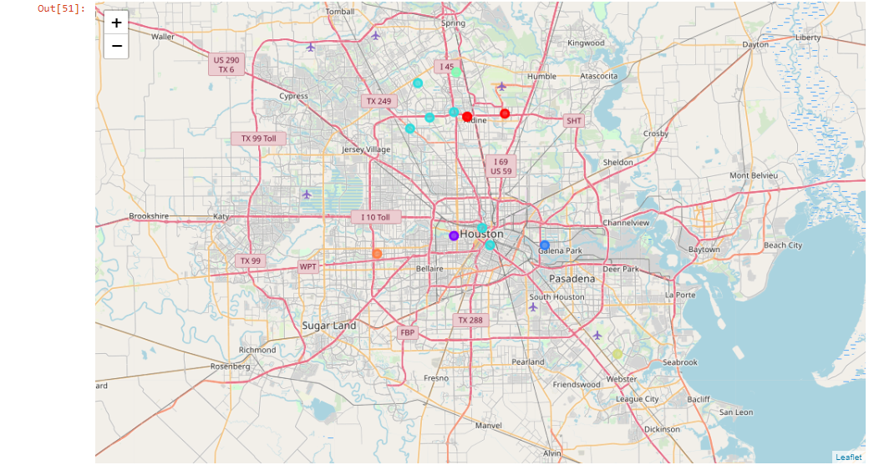
RESULTS
The districts are divided into clusters using the K means clustering algorithm. They are grouped into clusters based on the venues that they have.

Slide 6
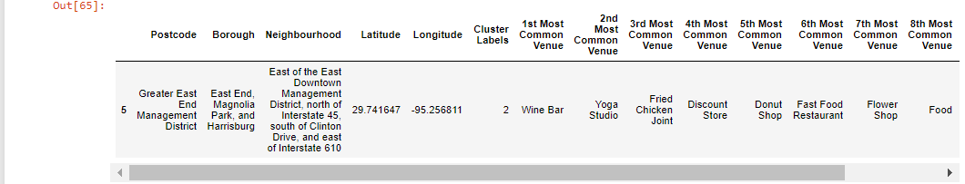
DISCUSSION
Cluster 2 has plenty of wine bars and yoga studios
The couple should look to move into this area

Slide 7
Conclusion
The couple should look to move to the Greater East End Management district based on their love for wine and yoga. This area would fit their needs the best.

